Slide 1
Waves, Sound, Light
Chapter 24
Blue Book

Slide 2
The Big Ideas of this Chapter
Sound and light are waves that transfer energy from one place to another.
Waves transfer energy outward from a vibrating object.
Sound is a compressional wave that travels only through matter.
Light waves are electromagnetic waves that travel in matter or space

Slide 3
Waves
A Wave is a disturbance that moves through matter or space.
Waves carry energy from one place to another by passing the energy from one molecule to the next as it spreads outward.

Slide 4
Waves
Types of waves
Transverse waves
Electromagnetic waves
Compressional waves

Slide 5
Waves
Transverse waves:
Causes particles in matter to move back and forth (Snake).
Parts of the transverse wave
Crest: high points
Trough: low points

Slide 6
Waves
Electromagnetic waves:
similar to transverse waves, however, these waves have electric and magnetic parts that vibrate up and down(perpendicular) to the wave direction.
Examples: light, radio, or x-ray waves

Slide 7
Waves
Compressional waves:
Causes particles to move back and forth along the same direction (Slinky).
Parts of a compressional wave
Compression: Crowding of the wave
Rarefaction: Spreading of the wave

Slide 8
Waves
Properties of waves: ways to describe a wave…
Wavelength
Frequency
Amplitude (Transverse wave)
Amplitude (Compressional wave)
Wave speed

Slide 9
Waves
Wavelength

Slide 10
Waves
Frequency
The number of wave lengths that pass a point each second.
Tip:
Transverse wave: view the number of crests or troughs that pass a point each second.
Compressional wave: view the number of rarefactions or compressions that pass a point.

Slide 11
Waves
Amplitude
Transverse wave
Compressional wave

Slide 12
Waves
Wave speed:
Try the practice problems on page 698

Slide 13
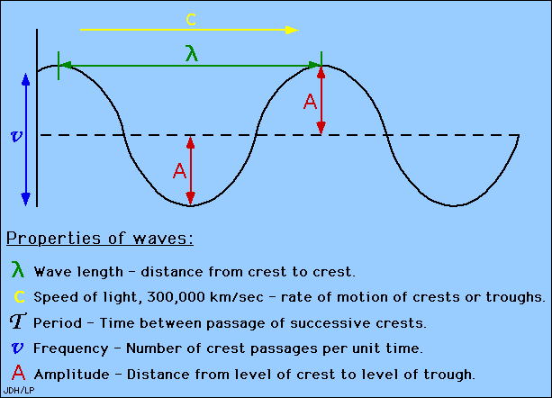
Review of wave properties

Slide 14
Waves
Waves can change direction!!
How could this happen??

Slide 15
Waves
Waves changing direction
Law of Reflection: the angle of the reflected wave is equal to the angle that the wave is released from.

Slide 16
Waves
Waves changing direction
Refraction: waves appear to bend when it travels through a different medium.

Slide 17
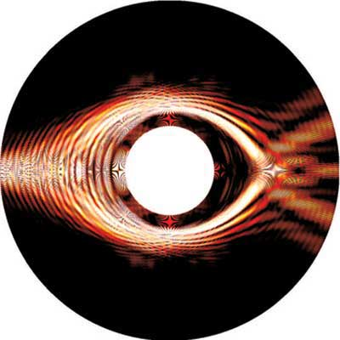
Waves
Waves changing direction
Diffraction: waves bend around an object

Slide 18
Waves
Questions??

Slide 19
Section 2:Sound Waves
Exit Extension: describe the motion of a transverse vs. a compressional wave.

Slide 20
Sound waves are fun and cool
Lets take a look…
http://www.youtube.com/watch?v=Ude8pPjawKI

Slide 21
Sound Waves
Sound waves are compressional waves that start by vibrating particles at the same frequency as the original material(noise).

Slide 22
Visual animations of sound waves
http://www.youtube.com/watch?v=aPswnDcteS4
http://www.youtube.com/watch?v=GkNJvZINSEY

Slide 23
Sound waves
Speed of Sound: like all waves sound can travel at different speeds depending on the material it must travel through.
Solid: Fastest
Liquid: medium
Gas: Slowest

Slide 24
Sound Waves
Loudness of a sound
Decibel Scale:

Slide 25
Sound Waves
Pitch: is the human perception of the frequency of sound. (low vs. high sounds)
The greater the frequency the higher the pitch

Slide 26
Sound waves
“Amp”litude changes the loudness of sound
The greater the amplitude the louder the volume.

Slide 27
Sound Waves
Questions/Review

Slide 28
Light
Electromagnetic Waves (including light): are waves that can travel through matter or empty space.

Slide 29
Light
Speed of light:
Light travels fastest in empty space
300,000km/sec
Light takes 8 ½ mins to get to Earth!!
Light travels slowest in solids (with particles)
197,000km/sec

Slide 30
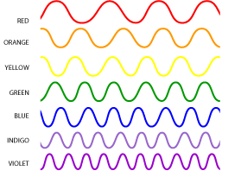
Light!!
Wavelength of light
Wavelength changes color of light.
The shorter the wavelength the cooler the color. The longer the wavelength the warmer the color

Slide 31
Light
Intensity of light waves changes when frequency changes
Brighter light comes with a higher frequency/dimmer light comes with a lower frequency

Slide 32
RAFTS Project
Waves

